Slide 1
Data Science
CSE-4075
(Machine Learning)

Slide 2
I am always ready to learn although I do not always like being taught.
Winston Churchill

Slide 3
Data Science is not only Machine Learning!
In fact, data science is mostly turning business problems into data problems and collecting data and understanding data and cleaning data and formatting data, after which machine learning is almost an afterthought.

Slide 4
What is Machine Learning?
“Learning is any process by which a system improves performance from experience.”
Herbert Simon
Definition by Tom Mitchell (1998):
Machine Learning is the study of algorithms that
• improve their performance P
• at some task T
• with experience E.
A well-defined learning task is given by <P, T, E>.

Slide 5
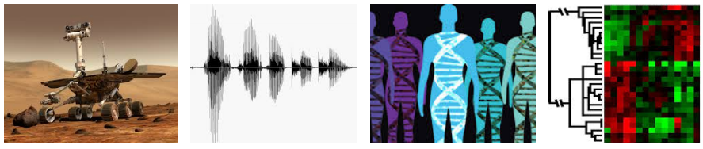
WHEN DO WE USE MACHINE LEARNING?
ML is used when:
• Human expertise does not exist (navigating on Mars)
• Humans can’t explain their expertise (speech recognition)
• Models must be customized (personalized medicine)
• Models are based on huge amounts of data (genomics)

Slide 6
What Is Machine Learning?
Traditional Programming
Machine Learning
Data
Computer
Output
Program
Data
Computer
Program
Output

Slide 7
Algorithms
Supervised learning
Prediction
Classification (discrete labels), Regression (real values)
Unsupervised learning
Clustering
Probability distribution estimation
Finding association (in features)
Dimension reduction
Semi-supervised learning
Reinforcement learning
Decision making (robot, chess machine)

Slide 8
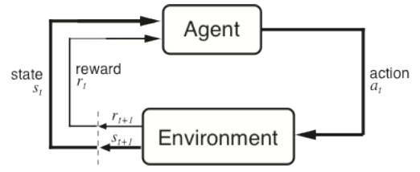
Algorithms
Supervised learning
Unsupervised learning
Semi-supervised learning
Reinforcement learning

Slide 9
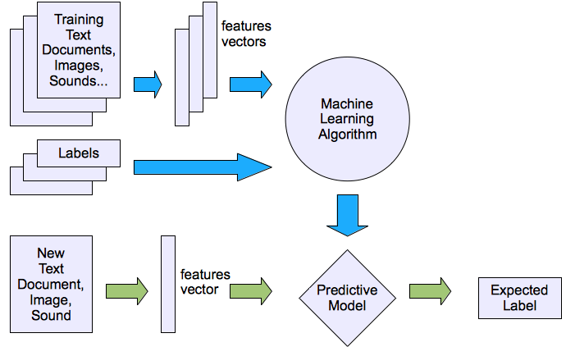
Machine learning structure
Supervised learning

Slide 10
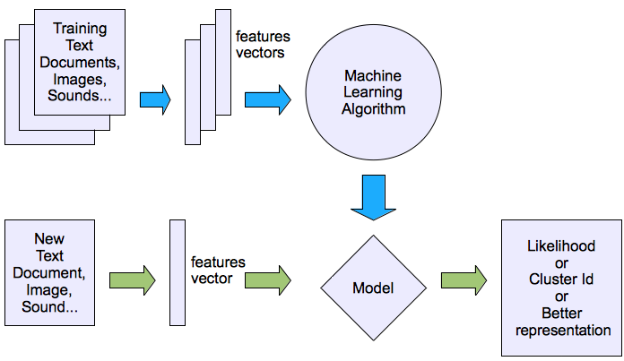
Machine learning structure
Unsupervised learning

Slide 11
Overfitting
Overfitting
— Producing a model that performs well on the data you train it on but that generalizes poorly to any new data.
This could involve learning noise in the data.
It could involve learning to identify specific inputs rather than whatever factors are actually predictive for the desired output.
Low bias but very high variance corresponds to overfitting.

Slide 12
Underfitting
Underfitting
— Producing a model that doesn’t perform well even on the training data.
This happens when selected model isn’t good enough. High bias and low variance typically correspond to underfitting

Slide 13
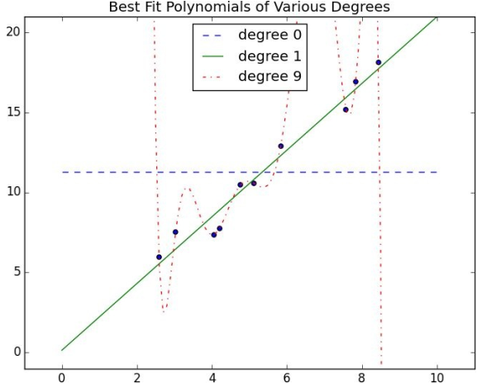
Overfitting and Underfitting

Slide 14
Overfitting and Underfitting
If your model has high bias (which means it performs poorly even on your training data) then one thing to try is adding more features.
If your model has high variance, then you can similarly remove features. But another solution is to obtain more data

Slide 15
Correctness
Imagine building a model to make a binary judgment. Is this email spam?
Given a set of labeled data and such a predictive model, every data point lies in one of four categories:
True positive: “This message is spam, and we correctly predicted spam.”
False positive (Type 1 Error): “This message is not spam, but we predicted spam.”
False negative (Type 2 Error): “This message is spam, but we predicted not spam.”
True negative: “This message is not spam, and we correctly predicted not spam.”

Slide 16
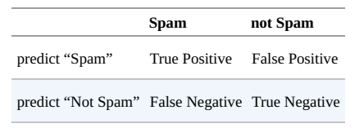

Correctness
We often represent these as counts in a confusion matrix:
Accuracy is defined as the fraction of correct predictions

Slide 17



Correctness
Precision measures how accurate our positive predictions are?
Recall measures what fraction of the positives our model identified.
A measure that combines precision and recall is the harmonic mean of precision and recall, the traditional F-measure or balanced F-score

Slide 18
Correctness
Suppose a computer program for recognizing dogs in photographs identifies 8 dogs in a picture containing 12 dogs and some cats. Of the 8 dogs identified, 5 actually are dogs (true positives), while the rest are cats (false positives). The program's precision is 5/8 while its recall is 5/12.
When a search engine returns 30 pages only 20 of which were relevant while failing to return 40 additional relevant pages, its precision is 20/30 = 2/3 while its recall is 20/60 = 1/3. So, in this case, precision is "how useful the search results are", and recall is "how complete the results are".

